Slide 1

RISK AND RESILIENCE BOOTCAMP
1

Slide 2


Slide 3
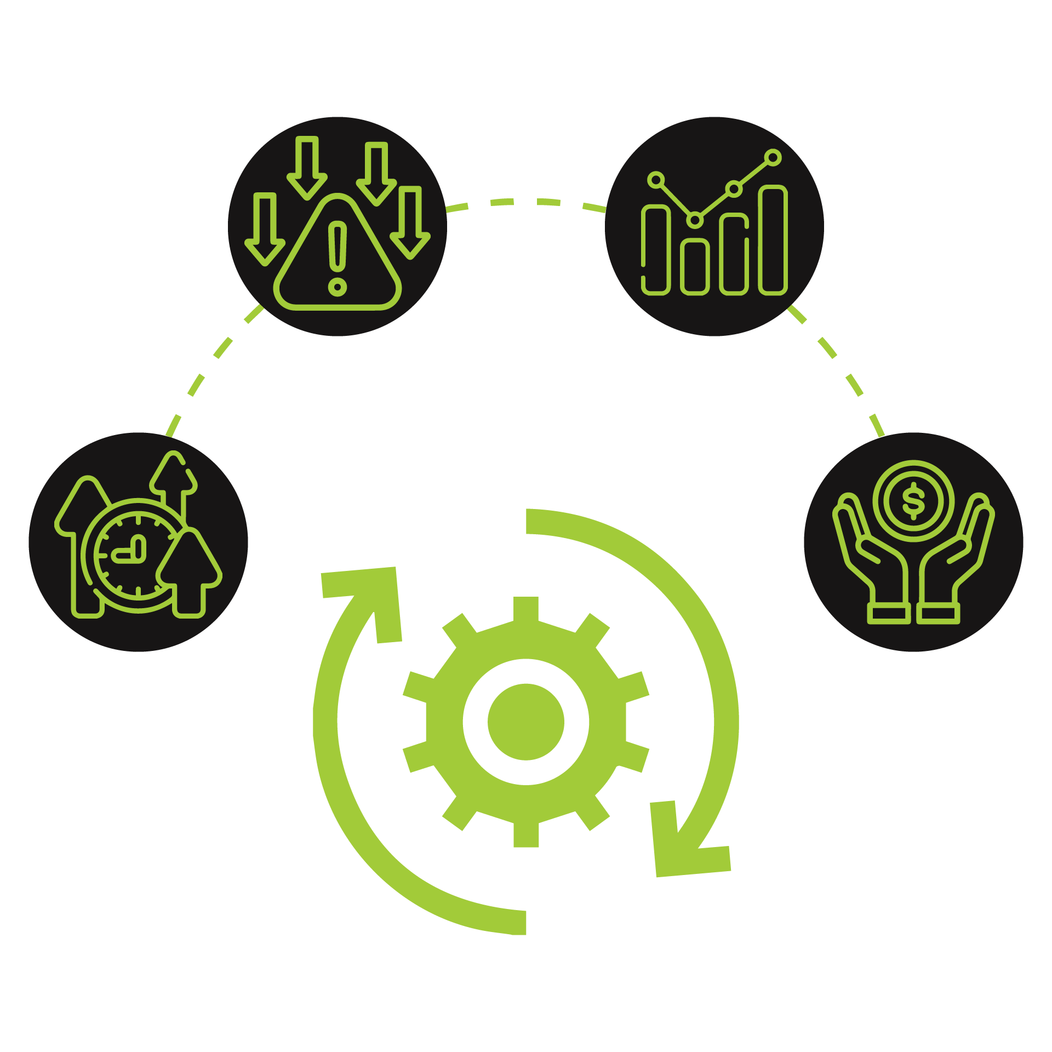
Business process modeling
This module introduces and explores business process modeling and related areas
BPMN
Bottleneck Analysis
RACI
Control Weaknesses

Slide 4
Business Process Modeling (BPM)
Why model business processes?
Organization manage risks from systems, controls and people
But often without a full picture of how work actually flows through the business
BPM helps to visualize, analyze and improve workflows
Essential for revealing where risks lie
In a risk and resilience context
Helps identify where inside the process might things go wrong
And what the resulting impacts would be

Slide 5
Business Process Modeling (BPM)
Modeling a process provides
Clarity about inputs, outputs, flows, handoffs, decisions and system dependencies
Common vocabulary and visualization across business & IT stakeholders
Basis for identifying latent risks and control weaknesses
For example: rework loops, human manual steps, system dependencies
A process map is not just a diagram of work
It is also a diagram of risk

Slide 6
BPM in Risk Identification
Applying BPM with a risk lens can uncover
Design risks
Does the process design introduce delays, loops, unnecessary manual work or complexity?
Execution risks
Are there unmonitored manual handoffs, people acting without backup, or lack of system support?
Dependency risks
Does the process rely on a single system or person (single point of failure)?
Are there external suppliers or upstream/downstream processes that create risk?
Control risks
Where are the monitoring or control points?
Are they visible and documented?
Are there gaps or overlaps in ownership?

Slide 7
BPM in Risk Identification
Applying BPM with a risk lens can uncover:
Data/information risks
How does data move?
Is there risk of data loss, corruption, incorrect handoff?
Change risks
If a process changes (e.g., new system, new regulatory requirement), how will the current flows adapt and what is the vulnerability during transition?
Modeling shifts the risk lens
From: “we hope nothing goes wrong”
To: “we can see where things can go wrong and can act”

Slide 8
Modeling Techniques and Tools
There are a number of standard toolsets used for business modeling
Business Process Model and Notation (BPMN) 2.0
The industry-standard notation for modelling complex business processes
Uses standard symbols (events, activities/tasks, gateways/decisions, flows) that both business and technical stakeholders can understand
Allows modeling from a “high‐level overview” down to more detailed subprocesses, enabling the modeler to drill down to the risk source
Using BPMN for risk modelling: some researchers suggest enriching BPMN with risk information (likelihood/impact): e.g., in a “risk-annotated BPMN” model

Slide 9
Modeling Techniques and Tools
Some tools are adaptations of older existing modeling techniques
Flowcharts, SIPOC diagrams, Value‐Stream Maps
These are useful, especially in earlier or higher‐level phases, or for less complex processes
Flowcharts
Simple, good for mapping steps, but may lack standardisation and clarity for cross-functional work
SIPOC (Supplier–Input–Process–Output–Customer) diagrams
Good for understanding the boundary/context of a process
Who supplies, what comes in, what goes out, who receives
Value-Stream Maps
Commonly used in Lean environments to show value-add vs non-value‐add steps, handoffs, delays
Useful for spotting bottlenecks and waste, which are also risk indicators

Slide 10
Risk Identification Step by Step
Select the process to model
Choose a process that is critical to business operations or IT-risk related
For example: customer onboarding, change-management, incident response, data access provisioning
Map the “as-is” process
Use BPMN or other notation to capture how work actually flows today
Include start/end points, tasks, decision points, handoffs, system steps, manual steps, exceptions
Use swimlanes/partitions if different departments or systems are involved
Annotate where the process uses systems, where people operate manually, where there are delays or dependencies

Slide 11
Risk Identification Step by Step
Overlay risk indicators on the model and ask:
Identify where are the handoffs occur
People to people
System to people, or vice vera
System to system
Identify manual steps or processes that could be automated or are error-prone
Identify loops or rework steps where there is a higher chance of delay or error
Is there a single person or system that if it fails, the process stops?
This is a single point of failure
Are the decision-points well documented, are there missing controls or lack of visibility?
How is data passed? Is it secure, accurate, validated?
What happens when exceptions occur? Are there contingency steps?

Slide 12
Risk Identification Step by Step
Risk modeling approaches often follow the process
Model the process
Use the model to prompt risk identification.
By analyzing each activity of a business process you are more likely to identify risks than by relying solely on unstructured brainstorming

Slide 13
Risk Identification Step by Step
Identify where control weaknesses exist
Highlight where controls are missing, ambiguous, redundant, or overlapping
For example
A manual approval step that has no logging or oversight
A task assigned to a person who also does approvals and execution (lack of segregation of duties)
A system dependency with no backup or no change control
Prioritize risk areas
Based on the process model, prioritize:
Likelihood of failure/disruption
Impact of that failure (financial, regulatory, reputational, operational).
The visual depiction of the process is a way to justify your prioritization
For example, identifying a single point of failure at a critical step

Slide 14
Risk Identification Step by Step
Design improvements
Once the model is overlaid with the identified risks
The process can be re-engineered by
Proposing controls
Identifying redundant paths
Identifying automation opportunities
Improving monitoring to enhance detective controls
The model becomes a communication tool with stakeholders

Slide 15
Flow of Risk
Traditional process modeling focuses on the flow of work
Adding a risk-aware lens, shifts focus to the flow of risk
How risk propagates through process steps, handoffs, and system interactions
For example:
If Task A feeds into Task B, and Task A is manual and error-prone
Then Task B can receive incorrect data
This is a risk flow because the risk flows from A to B
The process map visualizes the pathway of work and the pathway of potential failures, delays, rework, data leaks, control gaps
Visual modelling makes hidden dependencies visible
For example:
A system that triggers the next step but if it fails, the work stops
A manual check that is executed late or is incomplete
A hand-off between departments with unclear responsibility creating a risk blindspot

Slide 16
Integrating BPM into Risk analysis
BPM can be included foundation activity
Identify critical processes, map them, overlay risk and dependencies, feed those into the risk register or assessment
Use the diagrams in workshops with stakeholders
The visual nature aids understanding, builds engagement, and supports communication across business/IT
Treat the process models as living artifacts
Update when process changes occur, when new systems are introduced, or when control environment shifts
Otherwise they become stale and lose analytic value.
Link the process models to control frameworks
Mapping where controls reside or should reside
Map to resilience procedures like the resilience plan for the failure of a key step
Use the models during incident response or root cause analysis
When something failed, revisit the process model to see where the breakdown occurred

Slide 17
Bottlenecks
Once a process is mapped, it becomes possible to assess operational and systemic vulnerabilities
Bottlenecks
Stages where tasks accumulate due to resource constraints, approval delays, or inefficient handoffs
Indicators include high cycle time, queue buildup, or repeated rework.
Single points of failure (SPOFs)
Individuals, systems, or tools whose failure halts the entire process
Examples
A single IT administrator controlling access
A critical spreadsheet managed by one person

Slide 18
Bottlenecks
A place in a process where
The demand like work, tasks, information exceeds the capacity of that step like workers, system capacity, hand-offs or approvals
Slows down the overall flow.
The rest of the process may be efficient
But the bottleneck effectively limits the throughput of the entire end-to-end chain
Analogous to the neck of a bottle limiting the flow of liquid.
Bottlenecks may be temporary (short-term) or structural/chronic (long-term)
Short-term could be a system outage or a person’s absence
Long-term may be inherent capacity mismatch, workflow design fault, or outdated system

Slide 19
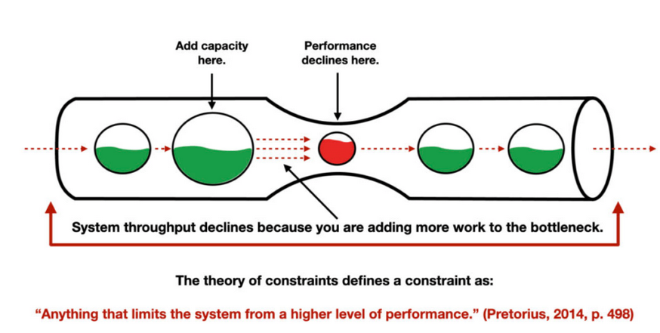
Bottlenecks

Slide 20
Bottlenecks in Risk
From a risk perspective, bottlenecks are critical because they
Increase cycle time and lead time, thereby delaying deliverables and reducing responsiveness
Create back-logs or work queues, which increase exposure to error, rework, and potential control failures
May indicate hidden single points of failure
For example, if one stage cannot scale or is highly dependent on a resource
Amplify the impact of other risks
For example, a bottleneck in a process may mean that when an upstream system fails, the backlog grows and uncontrolled work continues, increasing operational and compliance risk
Erode organizational resilience
If the bottleneck is not addressed, the system cannot adapt quickly to spikes in demand, external shocks, or changes in process

Slide 21
Common Types of Bottlenecks
Capacity constraints:
A person, team, or system cannot process work as fast as it arrives.
For example: one expert reviewer approves all change requests and is overloaded
Manual hand-offs or approvals
Tasks that require manual intervention, sign-off, or handover tend to be slower and more error-prone, introducing delay
System performance or outdated technology
Legacy systems, slow response times, or batch processing can create bottlenecks

Slide 22
Common Types of Bottlenecks
Handoff/transition delays across departments
When work moves from one team or system to another (especially across silos) delays often occur
Redundant, unclear or overly complex workflows
Too many steps, rework loops, unnecessary approvals all slow the process
Resource or role dependency (single person, single team):
When only one person or team performs a critical step, the process becomes fragile
Variability and unpredictable demand
Large fluctuations in work volume without matching capacity produce bottlenecks

Slide 23
How to Identify Bottlenecks
Step 1: Select the process scope
Choose a critical process
For example new-client onboarding, incident response escalation, change management
Define clear start and end points so you know what you’re analyzing
Step 2: Map the “as-is” workflow
Create a visual model (flowchart, BPMN, swimlane) showing steps, decision points, hand-offs, systems, manual tasks
Annotate
Where tasks queue
Where hand-offs happen
What systems are used
Who is responsible
Use data where possible
For example: cycle times, wait times, queue lengths.

Slide 24
How to Identify Bottlenecks
Step 3: Collect data and observe metrics
Key metrics
Lead time: time from request to completion, also called transaction time
Cycle time: time taken at each step
Throughput: units processed per period
Work-in-progress (WIP) queues
A step where WIP accumulates or where lead time spikes suggests a bottleneck
Obtain feedback from staff:
Which steps repeatedly cause frustration or backlog?
Which persons are over-utilized?

Slide 25
How to Identify Bottlenecks
Step 4: Identify the bottleneck(s)
Look for the step with the longest queue, highest utilization, longest processing time, or which restricts the entire process flow.
If this step were faster, would the overall process become faster?
If yes, than that step is a bottleneck.
Differentiate whether it is a constraint (systemic) or temporary overload

Slide 26
How to Identify Bottlenecks
Step 5: Analyze root causes
For an identified bottleneck, ask
Why is the backlog forming?
Why is the capacity insufficient?
Are there manual approvals?
Are resources constrained?
Are hand-offs inefficient?
Use techniques such as 5 Whys, fish bone diagrams
Examine the interfaces between people, process, system
For example: maybe the system is fine but hand-off between teams is slow because roles are unclear

Slide 27
How to Identify Bottlenecks
Step 6: Develop and implement solutions
Potential remediation
Redistributing workload
Adding capacity
Automating manual steps
simplifying workflow
Eliminating redundant steps
Establishing backup resources
Improving hand-off protocols.
Prioritize by impact
Fix the bottleneck that will yield the most improvement in overall process flow
Improving non-bottleneck steps yields little gain

Slide 28
How to Identify Bottlenecks
Step 7: Monitor and sustain
After implementing changes
Monitor metrics again to ensure the bottleneck is relieved
For example: lead time, cycle time, queue lengths
Bottlenecks may shift
Once one is removed, another may emerge elsewhere
Continuous monitoring is essential to identify emerging bottlenecks

Slide 29
Single Points of Failure
Bottlenecks are about capacity and throughput
Single points of failure (SPOFs)
SPOF is a person, system, or step whose failure (unavailability, error, outage) will stop or severely impair the process
A redundancy gap means there is no backup, alternate path, or contingency for a critical process step, rendering it fragile
From process modelling:
A step may appear fine in normal flow, but if the person responsible is absent, or the system fails, the process halts, that is a SPOF
Bottlenecks + SPOFs = elevated risk because when a bottleneck resource fails, the harm is much greater
Mitigation: design alternate paths, cross-train resources, ensure fail-over systems, incorporate contingency in process maps

Slide 30
Automation issues - process weaknesses
Automation issues are often linked to bottlenecks and SPOFs, automation plays an important role:
Manual tasks are often slower, error-prone, less visible, more susceptible to capacity constraints
These can become bottlenecks
Automation can improve throughput, consistency and reduce human dependency
But automation poorly designed or not maintained can itself become a bottleneck or failure point

Slide 31
Automation issues - process weaknesses
When modelling a process from a risk view
Annotate where manual work occurs
Where systems are used
Where automation might reduce delay and risk
Where automation is missing (gap), or outdated (risk of failure)
Example:
A manual approval system via email becomes overloaded and delayed; automating approval or providing self-service may reduce that bottleneck and improve resilience.

Slide 32
summary
To recap
Bottlenecks are systematic constraints in a process that limit throughput, slow flow, increase backlog and introduce risk
They may be due to people, process, or system issues (or combination thereof) and often highlight underlying fragility or resilience gaps
Identifying bottlenecks requires mapping the process, collecting data (lead time, cycle time, WIP), gathering feedback, and analyzing root causes
From a risk and resilience viewpoint, watch for single points of failure and lack of redundancy, as these amplify the impact of bottlenecks
Automation (or lack thereof) is a key factor: manual tasks increase bottleneck risk, but automation must be well-designed or it can itself be a fault
Regular monitoring is essential: once one bottleneck is relieved, another may emerge because the process needs to be a living risk-aware artifact

Slide 33
Swimlane Diagrams
A type of process map
Divides the workflow into “lanes” representing different roles, departments, teams or systems
Then places tasks/activities inside those lanes according to who/what is responsible
Also called a cross-functional flowchart or role-activity diagram
These can be applied to any sort of diagram that maps out a flow
Data flow diagrams, business process models, flowcharts, etc.
The visual metaphor
Like a swimming pool, where each lane is a different actor and the tasks “swim” across lanes
Unlike a diagram that just shows sequence, a swimlane diagram adds an extra dimension of responsibility/ownership, making “who does what” and “hand-offs” explicit
It is used especially when processes span multiple functions/teams or when hand-offs between teams/systems are common

Slide 34
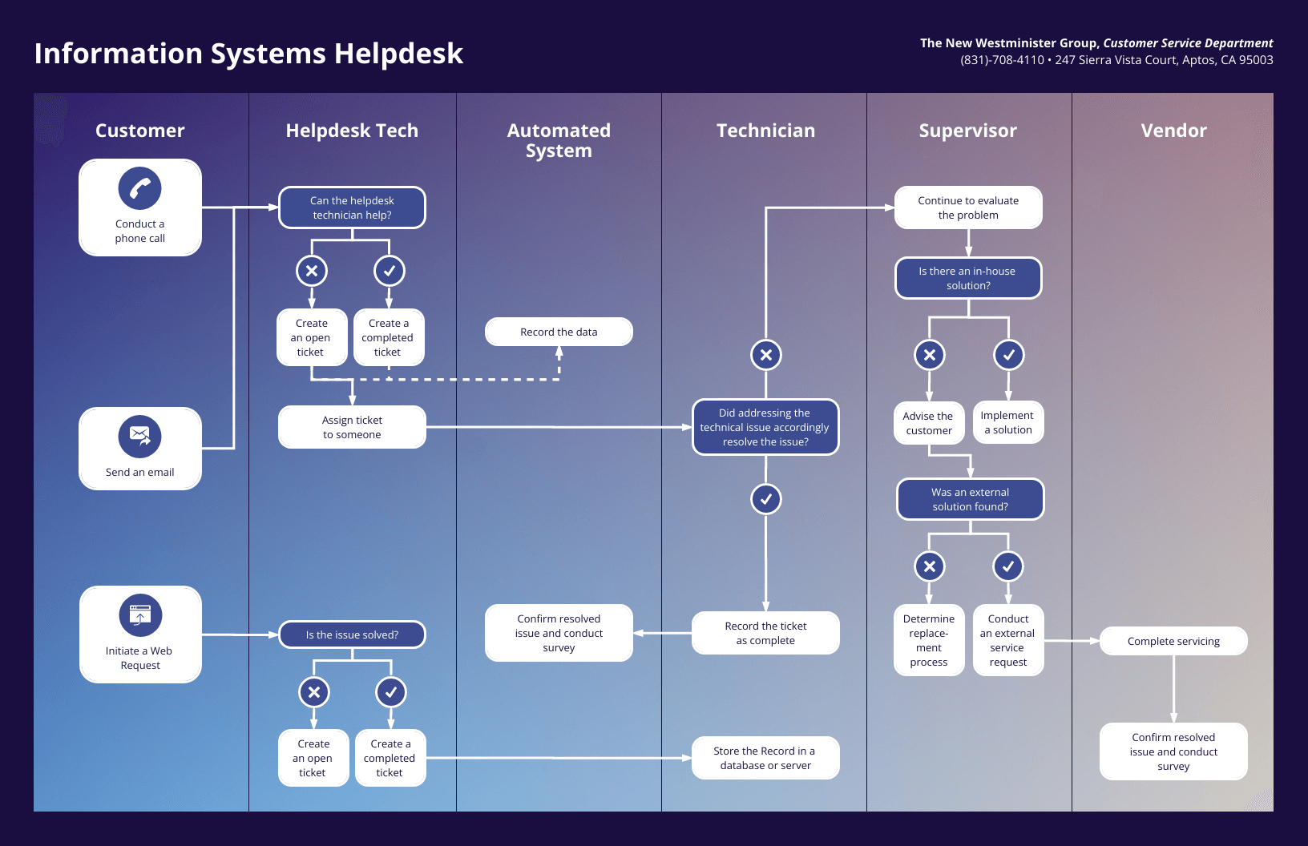
Swimlane Diagrams

Slide 35
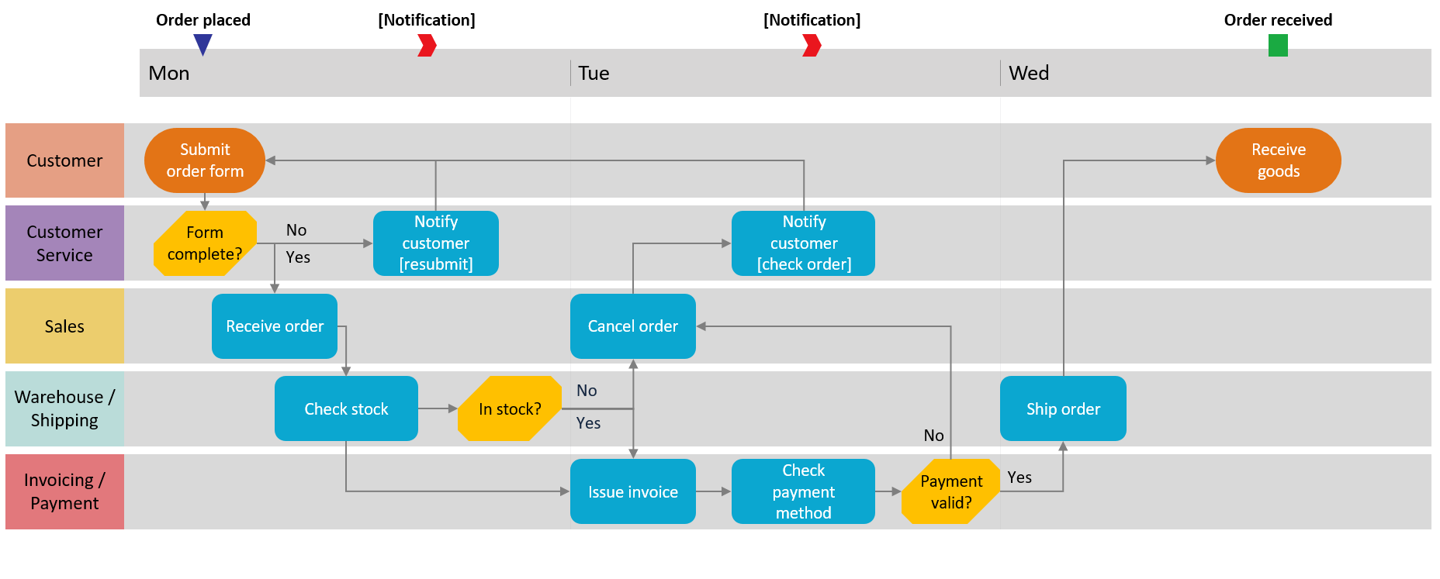
Swimlane Diagrams

Slide 36
Swimlane Diagrams
In risk analysis, swimlane diagrams serve several important purposes
Visualize how work and information move across organizational boundaries
A risk often arises when there’s a boundary crossing
Department to department, system to person, vendor to internal
Making that explicit helps highlight potential weak points
Clarify roles and responsibilities
If a task is shown in a lane labelled “IT Support”
But the subsequent decision appears under “Operations”
It is obvious who is accountable for what.
This helps uncover ambiguity in responsibilities, duplication of tasks, or gaps (no one assigned)

Slide 37
Step-by-Step
Step 1: Define the scope
Choose the process to model
For example: change-management workflow, incident response, vendor onboarding
Identify start and end points; determine the high-level boundaries of the process
Step 2: Identify the participants / roles / systems (Lanes)
List all the roles, departments, systems, external parties involved.
Decide how to organize lanes
For example: by department, by role, by system, or by both
Label each lane clearly
For example: “Business Unit”, “IT Security”, “Compliance”, “Operations”, “Vendor”

Slide 38
Step-by-Step
Step 3: Map the steps/activities
For each step place it in the appropriate lane, depending on who/what executes it
Use arrows/flows to show how tasks move from lane to lane (hand offs), or loop back
Include decision points or gateways where relevant
Annotate if a system step, manual step, or external hand off
Step 4: Highlight hand offs and dependencies
Identify where flows cross from one lane to another
Those are hand off points
Identify where activities depend on another role/system completing a task before proceeding
Mark these in the diagram and note possible risks

Slide 39
Step-by-Step
Step 5: Review for role clarity and gap identification
Once mapped, ask
Does every task have a clear owning lane?
Are there tasks that span lanes without a clear hand-over?
Are there “white-spaces” (steps with no lane/owner)?
Are there loops or back-and-forth between lanes?
These may indicate confusion or inefficient handoffs
Ask also
Who is accountable (versus simply responsible) for each lane/task?
Where might someone think “it’s someone else’s job”?
Where might communication fail (between lanes/roles)?

Slide 40
Step-by-Step
Step 6: Use the diagram to spot risks
Look for
Lanes with many incoming/outgoing flows → heavy hand-off load → higher risk of delay/communication error
Lanes that are lightly populated (few steps) but receive many inputs or send many outputs → potential bottleneck or dependency
Cross-lane arrows with no clearly annotated control or check step → risk of drop
External lane or vendor lane handoffs (less control visibility) → elevated risk
For each risk spot identify:
What if the lane fails (person absent, system down, vendor unresponsive)?
What is the impact and how many other lanes depend on it?

Slide 41
Step-by-Step
Step 7: Communicate and maintain
Use the diagram in stakeholder workshops
It helps non-technical people like business executives visualize roles and dependencies
Treat it as a living artifact
When process or person roles change, update the diagram rather than leaving it stale
Link it to your risk register, controls library, or accountability frameworks
For example,connect a lane to a RACI chart

Slide 42
considerations
Risk considerations
Within departments often there’s clearer role definition, standard operating procedures, closer supervision
This usually means fewer surprises but it is still possible to overlook something
Boundaries or hand-offs between departments/roles often create risk because
It may be unclear who is responsible for the next step
Communication may be informal or undocumented
Systems may change across boundaries
There might be delays while waiting for another team.
The receiving team may not have full context or may assume something is already done

Slide 43
RACI Charts
A RACI chart (or matrix)
A responsibility assignment matrix (RAM) that maps tasks (or activities/decisions) against roles or stakeholders
It and assigns for each intersection one of the four RACI categories
Responsible (R)
Accountable (A)
Consulted ©
Informed (I).
In practice, the tasks are listed down the rows (left column)
Stakeholders/roles across the columns at the top
Then each cell is used to show each role’s involvement in that task
The purpose is to ensure clarity of roles and avoid confusion, overlaps, omissions, or ambiguity in responsibility and decision-making

Slide 44
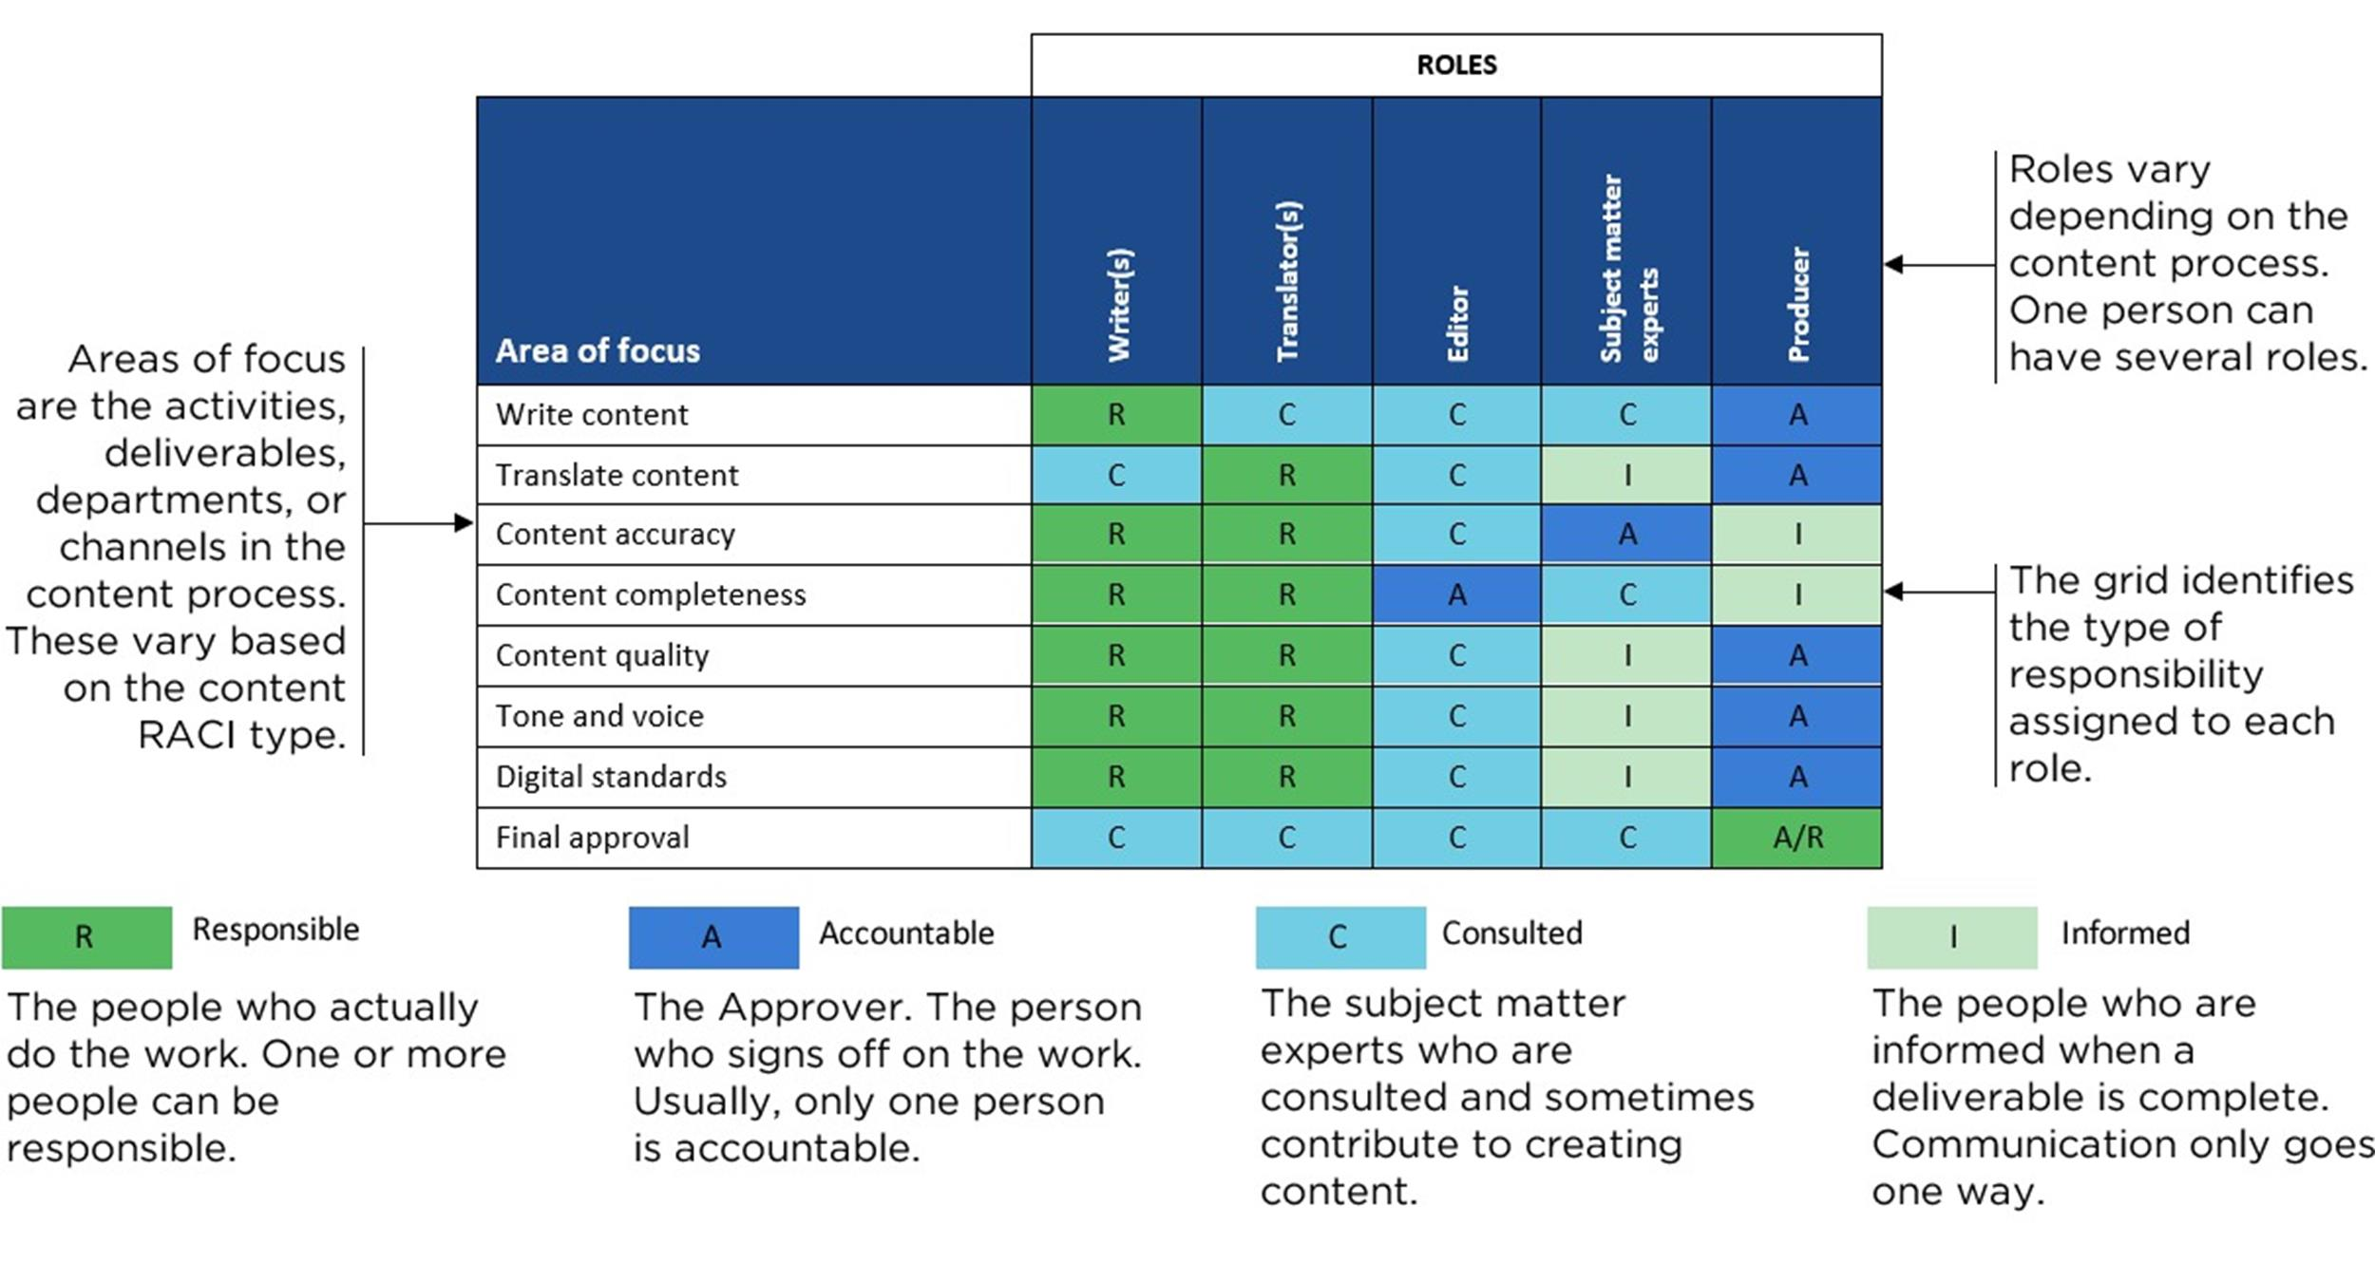
RACI Charts

Slide 45
RACI roles
Responsible (R):
The person or people who actually do the work to complete the task
The “doers”
Everyone doing the work should be identified
Accountable (A):
The person who is ultimately answerable for the correct completion of the task, deliverable, or decision
They own the outcome, must approve/sign-off, and bear consequences for success/failure
Per best practice, each task should have exactly one Accountable person

Slide 46
RACI roles
Consulted (C):
People or roles whose opinions are sought
Typically subject-matter experts, stakeholders who must give input before the task/decision is done
They are engaged in a two-way communication
Informed (I):
People or roles who need to be kept up-to-date on progress or results
They are not directly involved in doing the work or inputting decisions, but they need awareness
One-way communication.

Slide 47
Step-by-Step
Step 1: Identify Activities / Tasks / Decisions
List the set of tasks or decision points for the process or system you are analyzing
For instance
Initiate change request
Review risk impact
Approve change
Implement change
Monitor change outcome
Decide on the level of granularity, you may want to limit to high-level tasks for clarity

Slide 48
Step-by-Step
Step 2: Identify Roles / Stakeholders
Identify all relevant roles (not necessarily individual names) that will be involved
Example
Business Owner
IT Security Lead
Compliance Manager
Change Manager
Operations Team
Capture roles rather than always names, so the chart remains valid over time

Slide 49
Step-by-Step
Step 3: Build the matrix structure
Create a table/spreadsheet with rows = tasks/activities, columns = roles
For each cell, assign R, A, C, or I as appropriate.
Ensure that there is at least one “R” per task and exactly one “A” per task
Consulted and Informed may have multiple assignments
Step 4: Validate with stakeholders
Review the draft with relevant stakeholders to confirm the assignments
Lack of input from stakeholders may mean there are hidden gaps
Check for common problems:
No “A” assigned for a task
Too many “R” (means duplication or ambiguity)
Same person in multiple roles without clear justification

Slide 50
Step-by-Step
Step 5: Risk identification and control mapping
Once the RACI chart is populated, analyze for risk
For example: tasks where “I” stakeholders are missing could mean decision makers aren't being informed, leading to lack of control oversight
Link tasks that have high risk or critical control to the “A” role
That person then owns risk acceptance for that control
Assign monitoring, assurance, escalation responsibilities via “R/A”
Step 6: Maintain and update
The RACI chart becomes a living document
When processes change, roles evolve, or new tasks are added, updates are necessary
Otherwise it becomes stale and misaligned
Make it accessible and reference in governance meetings

Slide 51
Diagnostic Uses
Use the RACI chart to identify potential problems with controls
No Accountable assigned or multiple people assigned to Accountable
When nobody or too many people own a task, decision-making stalls
Too many Responsible roles
Several people marked “R” for same task can create duplication, confusion and lack of clarity.
Excessive Consulted/Informed roles
Over-communication can slow processes
Too many “I” roles may add noise

Slide 52
Common Errors
Rigid/static chart
If not updated, the RACI chart becomes outdated and misleading
Too granular
If every small step has a RACI assignment, the matrix becomes heavy and unwieldy
Apply suitable level of granularity
Misalignment with process map
If tasks in process map and tasks in RACI chart don’t correspond, then there is the potential for control gaps

Slide 53
Identifying Control Weaknesses
Processes don’t fail only because of technical or system flaws
Often the weakest link is people, communication, or organizational structure
Any shortcoming or gap in the design or operation of a control that increases the risk of error, fraud, or non-compliance
Communication breakdowns often occur
Example: lack of timely, accurate information flowing between roles, teams, systems
These can turn what might be a minor issue into a major incident
Because necessary escalation, monitoring or remediation does not happen

Slide 54
Key diagnostic issues
Role confusion
When duties overlap, when it is unclear who is supposed to perform or approve a task
Potential issues: duplicated work, missed work, or absence of control
For example: Two teams think the other will perform the hand-off check.
As a result none performs it resulting in a control gap
Possible design deficiency of control: lack of clarity as to who is responsible
Possible operational deficiency: control exists but how to execute it is unclear

Slide 55
Key diagnostic issues
Lack of Accountability
Often when tasks are assigned to “everyone” or “anyone” then there is no clear owner of the outcome
Without an accountable person, no one drives it, no one maintains oversight, no one escalates when things go wrong
Absence of “Accountable” in the RACI or missing “A” for a task means that control is weak or ineffective
Frequently shows up in control testing as “no one signed off” or “no owner of the exception” when a failure occurs

Slide 56
Key diagnostic issues
Communication Gaps
Key information not shared or delayed across teams, departments or levels
Example: A security vulnerability is discovered but is not communicated to the business until a change request is processed which results in the hand-off failing
Communication gaps are especially dangerous because they often don’t show up in routine operations but when an incident or exception occurs
These are the situations where speed and clarity matter
Edge cases and outliers are often where communication breaks down
No one has done a walk through of rare event occurrences because they were overlooked
Missed exceptions are often handled by ad hoc initiatives
These have to be converted to SOPs and run books to update the controls

Slide 57
Key diagnostic issues
Cultural Factors
If the organizational culture is a “blame culture”, employees may not escalate issues, near-misses or process deviations
They may hide or ignore them
This delays remediation, meaning control weaknesses persist
A risk-aware culture, encourages reporting, learning, escalation
Without this attitude, the “people” and “process” pieces of the risk triangle weaken
A well-designed process will still fail if people don’t feel safe to raise issues
Or if they lack clarity on roles and communication protocols

Slide 58
Step-by-Step
Step 1
Use process models and RACI charts as a baseline
These are the artifacts reviewed to check alignment
Are responsibilities clearly assigned?
Are hand-offs clear?
Where does communications between roles need to happen?

Slide 59
Step-by-Step
Step 2
Review control points and hand offs
On the process map, identify every control step: approvals, reviews, checks, data validations, hand-offs
For each control step, ask
Who is performing this? Do we have a clear owner?
What happens if this doesn’t occur? Is there a backup?
Are there hand-offs (cross-team, cross-system)? If yes, is the receiving party clearly defined?
On the RACI chart, ask
Are tasks with controls assigned a clear “A” (Accountable)?
Are the “C” (Consulted) or “I” (Informed) roles too many (information overload) or missing?
Where are the overlaps or omissions?

Slide 60
Step-by-Step
Step 3
Survey and interview stakeholders
Speak with people doing the tasks; ask
Do you know your role clearly?
When you hand-off to another role/team, do you always follow the same procedures?
Have you ever waited on someone else to complete a task you thought you’d done?
Have you ever found you weren’t aware of a change and you carried on in error because you weren’t told?
Look for signals of communication breakdown
For example: repeated rework, tasks waiting on outside team, missing documentation, undocumented exceptions

Slide 61
Step-by-Step
Step 4
Analyze control effectiveness
For each control step, evaluate
Design: Is the control well explained, documented, and aligned with the risk it is intended to mitigate?
Operation: Is the control executed reliably, consistently? Are there exceptions, workarounds?
Use frameworks that control weaknesses into design vs operational vs administrative weaknesses
Identify communication weaknesses
For example, controls that rely on hand-written log entries, manual emails with no receipt, or informal verbal escalation

Slide 62
Step-by-Step
Step 5
Categorize, prioritize and document weaknesses
Create a table or register
Each row = identified weakness or communication gap
Columns (suggested)
Process step
Description of weakness
Risk impact
Root cause (people/process/system)
Proposed remediation
Priority
Typical categories
Role confusion, missing accountability, unclear hand-off, un-documented escalation, culture/behaviour issue
Prioritize on impact (how bad if fails) and likelihood (how likely based on current state)
Using the standard risk scoring used in the risk analysis

Slide 63
Step-by-Step
Step 6
Develop mitigation and remediation strategies
For each identified weakness, propose targeted actions
Clarify or rewrite task/role descriptions; update RACI and process map
Assign clear Accountable roles; eliminate “everyone’s job”
Formalize communication/handoff protocols (who informs whom, what format, timeline)
Conduct training and change management to shift culture (from blame to reporting)
Automate where possible to reduce hand-offs and manual communication
Add monitoring/controls to catch missed hand-offs or uninformed stakeholders
Embed review mechanism:
The control environment must be monitored and updated regularly
Continuous monitoring helps surface weaknesses early

Slide 64
Step-by-Step
Step 7
Monitor and sustain
After remediation, embed KPIs/metrics to monitor the effectiveness of the controls
For example: number of hand-off delays per month, number of un-approved tasks, number of escalations raised vs expected
Conduct periodic process walkthroughs with stakeholders
Review culture indicators
For example: number of risk/incident reports raised, near-miss reports, time to escalate
Use the process map + RACI + control register together as a living document
Revisit when process or organization changes

Slide 65

Q&A and open discussion
Notes:
Now is the time to engage in an interactive Q&A session where you can ask questions, share insights, and clarify any doubts about the topics we have covered so far.
This open discussion is designed to ensure that every participant has the opportunity to voice their thoughts and learn from the collective experience of the group.
Your questions and comments are valuable as they help us identify areas that may need further explanation and enable us to tailor future sessions to your needs.
We encourage you to speak up and contribute to the dialogue, as this interaction is one of the key components of our interactive learning approach.
As the session progresses, take note of any questions or ideas that you would like to revisit, and feel free to share your perspectives with the class.

